Slide 1


Title: Impact of Smoking and Drinking on Health in South Korea Presenter: Priyanka Logasubramanian Institute: West Chester University, PA

Slide 2






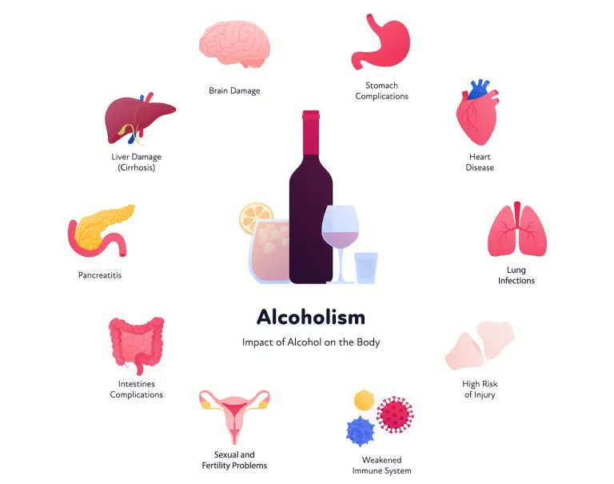


Research Motivation

Slide 3
Abstract Overview
Aim: Examine the health impacts of smoking and drinking.
Method: Predictive modeling with a focus on logistic regression.
Results: Disease patterns linked to behaviors.
Impact: Insight for health policy.

Slide 4

Exploring the Dataset
Source: National Health Insurance Service, South Korea.
Content: Blood readings reflecting the health impacts of smoking and drinking.
Aim: Detect patterns to identify related diseases.

Slide 5
Problem Statement
Concern: Health risks from smoking and drinking in Korea.
Goal: Predict risk behaviors and inform policies.

Slide 6
Literature Influences
Sung et al. (2022): Stroke analysis with ML and cross-validation.
Fazakis et al. (2021): Diabetes prediction with ML, used cross-validation.
Nopour et al. (2022): COVID-19 rapid diagnosis via logistic regression.
Boateng & Abaye (2019): Health analysis with logistic regression.
Lamb et al. (2008): Emphasized statistical rigor with t-tests.

Slide 7


Methodology Overview
Data Collection:
Statistical Exploration:
Normality Tests: Ensure data distribution.
Histograms & Q-Q Plots: Visual data analysis.
Correlation Matrices: Identify relationships.
T-tests: Compare groups.
P-value Analysis: Significance testing.

Slide 8
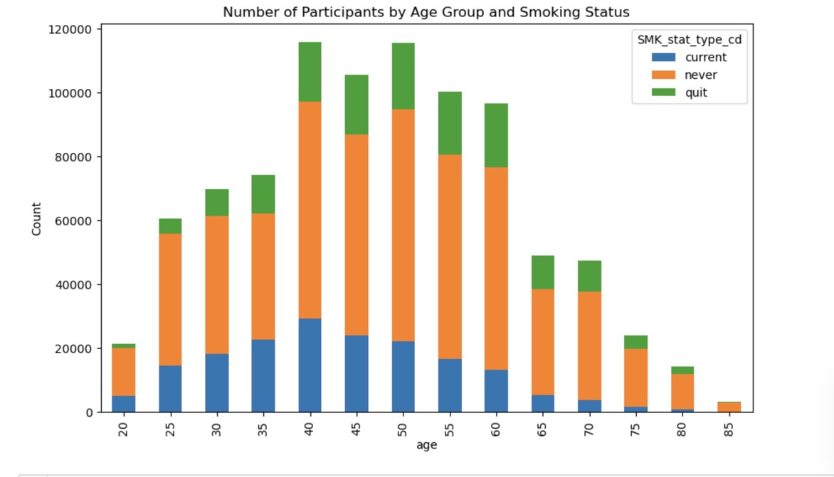
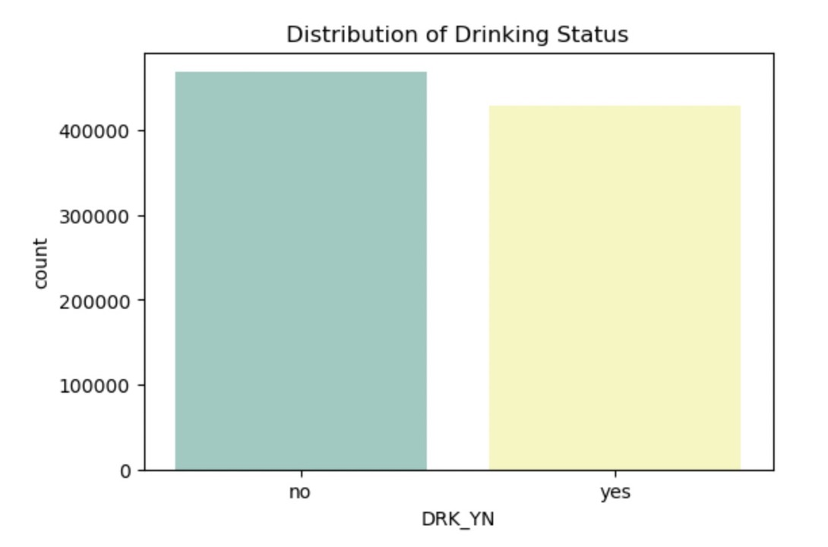
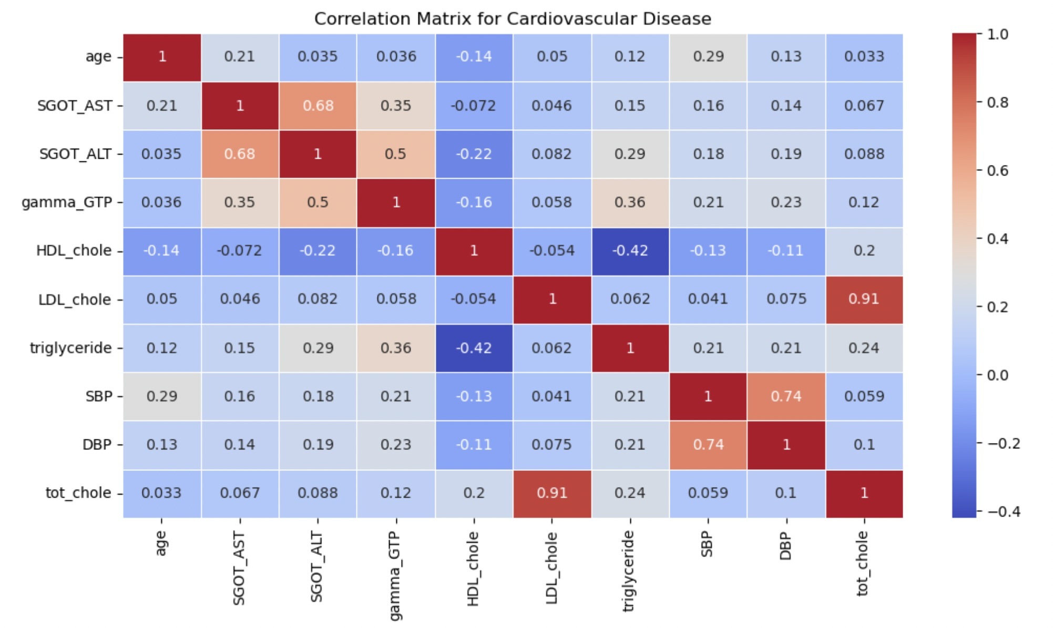
Demographic Distribution of Health Behaviors
Correlation Matrix and Heatmap Insights
Visualizing Lifestyle Distributions:
Smoking Trends
Drinking Trends

Slide 9
Metric | T-statistic | P-value | Significance
HDL Cholesterol | 57.060 | 0.0 | Significant
LDL Cholesterol | -41.271 | 0.0 | Significant
Systolic BP | 9.375 | 6.91e-21 | Significant
Diastolic BP | 73.475 | 0.0 | Significant
Gamma GTP | 258.220 | 0.0 | Significant
SGOT (AST) | 18.939 | 5.60e-80 | Significant
SGOT (ALT) | 54.661 | 0.0 | Significant
Triglyceride | 54.452 | 0.0 | Significant
T-test & P-value Results - Health Metrics in Drinkers

Slide 10
T-test & P-value Results - Health Metrics in Smokers
Metric | T-statistic | P-value | Significance
Total Cholesterol | -4.116 | 3.85e-05 | Significant
HDL Cholesterol | -134.596 | 0.0 | Significant
LDL Cholesterol | -6.319 | 2.64e-10 | Significant
Systolic BP | 23.984 | < 1e-126 | Significant
Diastolic BP | 60.608 | 0.0 | Significant
Gamma GTP | 254.552 | 0.0 | Significant
SGOT (AST) | 20.856 | < 1e-95 | Significant
SGOT (ALT) | 116.617 | 0.0 | Significant
Triglyceride | 157.239 | 0.0 | Significant

Slide 11
Key Predictors in Smoking and Drinking Behaviors
Feature | Coefficient
HDL_cholestrol | -0.126362
LDL_cholestrol | -0.037282
triglyceride | 0.060816
gamma_GTP | 0.314801
SGOT_AST | 0.060816
DBP | -0.078638
Feature | Coefficient
HDL_cholestrol | 0.207087
LDL_cholestrol | 0.124485
triglyceride | 0.004123
SBP | 0.251613
DBP | 0.255192
gamma_GTP | 0.755881
SGOT_AST | -0.117200
DBP | -0.108605
Coefficients For Each Feature in The Logistic Regression Smoker Model
Coefficients For Each Feature in The Logistic Regression Drinker Model

Slide 12
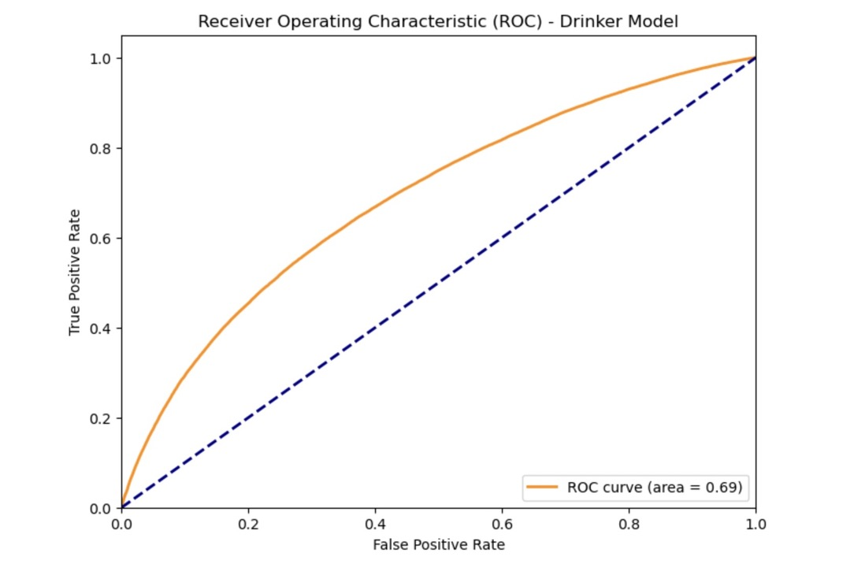
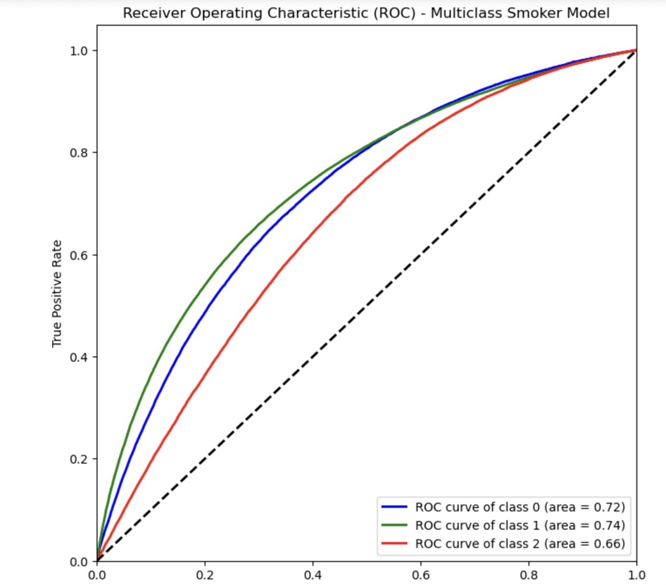
Model Efficacy: ROC Curves Analysis

Slide 13
10-Fold Cross-Validation for Smoking and Drinking Model
 |  |  |  |  | TEST
10 folds
Smoking model
 |  |  |  |  | TEST
10 folds
Drinking model

Slide 14
Results Highlights
Smoking model AUC: 0.71 (robust classification)"
"Drinking model AUC: 0.69 (moderate efficacy)"
Significant predictors: Gamma-GTP, cholesterol,BP
Confirmed consistency across classes via
cross-validation

Slide 15
Discussion Insights
BP readings: complex relation with drinking
Gamma-GTP links to smoking & drinking habits
Cholesterol levels vary with substance use
Model validates health risks of lifestyle choices

Slide 16
Conclusion & Future Directions
Future work: Longitudinal studies & diverse samples.
Aim for wider applicability in public health policy.
Anticipate refining models with more variables.
Validated models with AUC: Smoking (0.71), Drinking (0.69)

Slide 17


Slide 18


